Slide 1
Fast-Batched Optimal Solution for RTOPF
James, Mert, Vishal

Slide 2
Introduction

Slide 3
Introduction
Optimal Power Flow problem (OPF): Deciding the optimal operating conditions (minimizing power generation cost) for a power-plant based on (predicted) demand.
Real-Time OPF (RT-OPF): Solving the problem in real time – matter of minutes/seconds! - Traditional OPF solvers can't handle it
Renewable energy generators – introduce uncertainty
Two-fold problem:
Handle uncertainty (run more scenarios!)
Accelerate solution process
Solution given by the paper:
A distributed implementation of PDIPM – 3 kernels

Slide 4
Methods

Slide 5
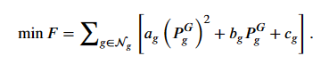
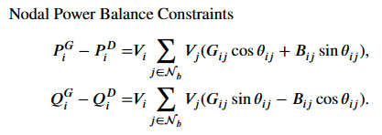
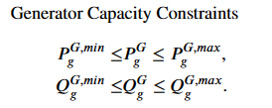
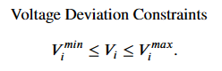
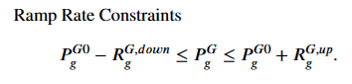
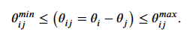
Methods
CPU

Slide 6
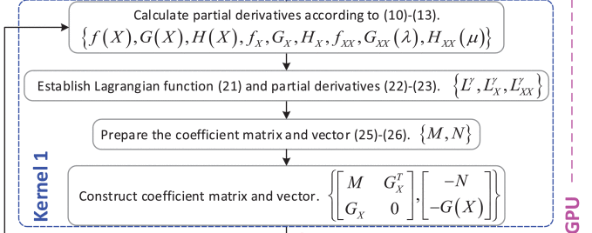
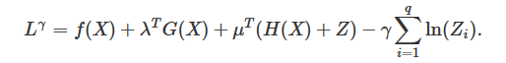
Methods
CPU
Kernal 1 Setup
Calculation of partial derivatives of the objective and constraints.
Lagrangians are computed and the matrix is generated
Additionally, as our matrices are stored in CSR format, matrix concatenation is a more complicated business

Slide 7
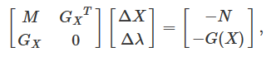
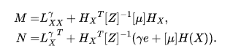
Methods
Computation of M and N values for cuSolver input
Once again using CoDiPack to compute the Derivatives
Using BLAS to compute the M and N values

Slide 8
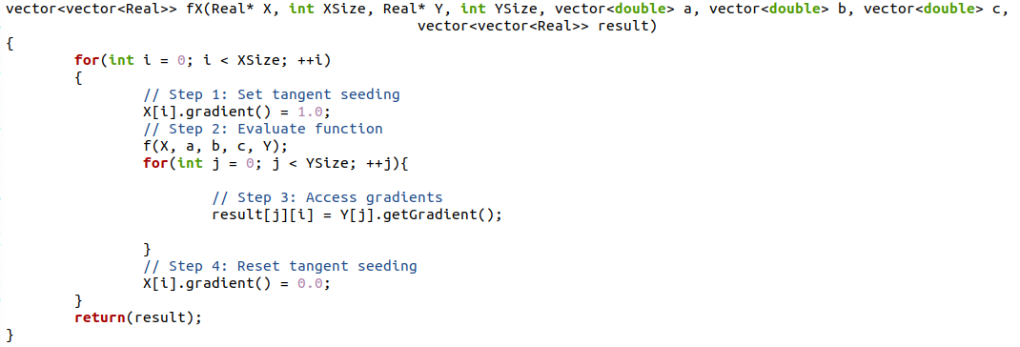
Methods
First Derivative Computation
Derivatives were computed using CoDiPack's RealForward type

Slide 9
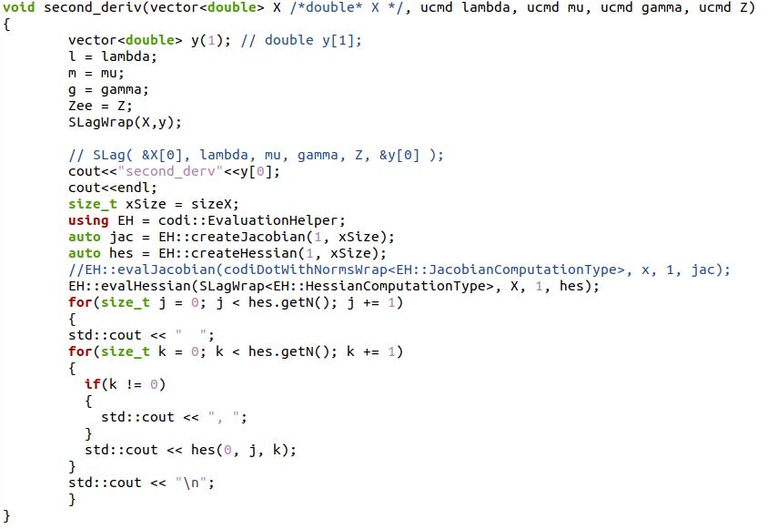
Methods
2nd Derivative Computation
Derivatives were computed using CoDiPack's evalHessian

Slide 10
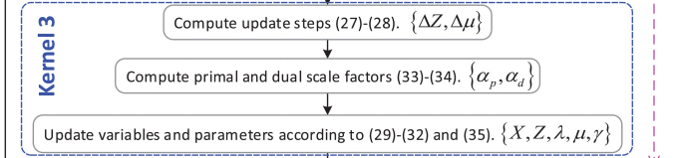
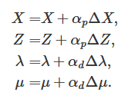
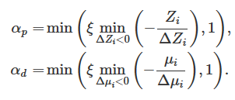
Methods
CPU
Kernal 3 Setup
The solved linear equation is used to compute and evaluate the update steps for the decision variables for the next iteration

Slide 11

Methods
GPU
Kernal 2 Setup
This is the most compute intensive set as it involves matrix inversion (solving of a linear system of equations). This is accomplished using CuSolver
Solves for ΔX and Δλ

Slide 12
Methods
cuSolver and cuSparse
cuSparse and cuSolverSp
cuSparse: Provides primitives for sparse matrix operations (e.g., CSR format) crucial for handling large sparse matrices efficiently.
cuSolverSp: Specializes in solving sparse linear algebra systems using factorization methods including QR decomposition
QR Decomposition Overview
QR decomposition is used to factorize matrix A to efficiently solve linear systems Ax=b and least squares problems.
Our paper utilizes batched QR solutions to handle dynamic adjustments in power systems with high renewable integration.
Matrix Construction:
From our previous computational process steps, we obtain a large sparse matrix A in column-major format and vector b representing the system states.
Problem Formulation:
Solve for x in Ax=b, where A is derived from system dynamics and constraints influenced by renewable energy sources
Conversion to CSR Format
CSR (Compressed Sparse Row) format optimizes non-zero matrix entries storage, reducing memory usage and computation time.
We convert the A matrix from column-major to CSR format, enabling efficient use of cuSolverSp routines.

Slide 13
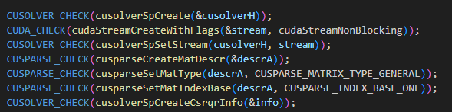
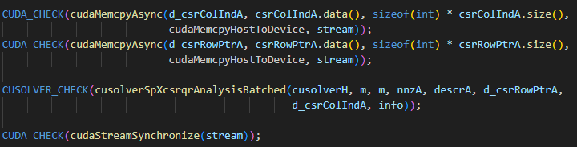
Methods
cuSolver Computational Steps Overview
Set up cuSolver and cuSparse contexts, define matrix descriptions.
Perform structural analysis on A&b using cusolverSpXcsrqrAnalysisBatched.

Slide 14
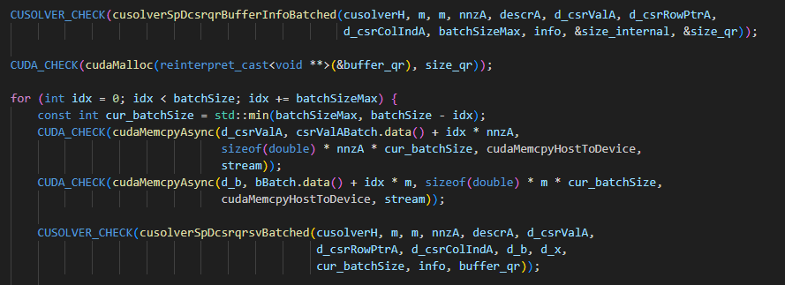
Methods
cuSolver Computational Steps Overview
Execute QR decomposition with cusolverSpDcsrqrsvBatched to solve Ax=b.
Fetch the solution vector x from GPU to CPU

Slide 15
Progress and Current Results

Slide 16
Results
Solving for Cases 14
Utilized CVXPY, a Python-embedded modeling language for convex optimization problems (CPU)
Compared performance using SCS and OSQP solvers
Utilized cuSolverSparse, an NVIDIA sparse matrix solver (GPU)
Factorization
Solver | Solution Time (s) | Speedup (OSQP baseline)
SCS | 0.02 | 1.00
OSQP | 0.0089 | 2.25
cuSolverSparse | 0.05* | 0.4*
Notes:
Mention

Slide 17
Further Research

Slide 18
Further Research
RealForwardCUDA
Improve ability to perform parallelized Automatic Differentiation
Further expand to nested differentiation for nth order derivatives
BLAS package improved utilization
Improve ability to perform operations
Matrix Concatenation
Diagonal/Full Matrix Inversion
Increased Type Safety
Reduce excessive type shifting
Current code is very type sensitive, requiring operations to change matrices to pointers, vectors to pointers, pointers to vectors, etc.
cuSolver Batched Mode
Were unable to use 100% of cuSolver's power to solve many problems at once
Current implementation performed one 1 type of problem

